Slide 1
lIC
Life insurance corporation of india
Presented team by:
R.PRATYUSHA
A.HARITHA
A.HARIKA
B.SAI SRUTHI
D.SINDHU

Slide 2
Main theme of LIC
Yogakshemam Vahamyaham” meaning “Your welfare is our responsibility”.

Slide 3
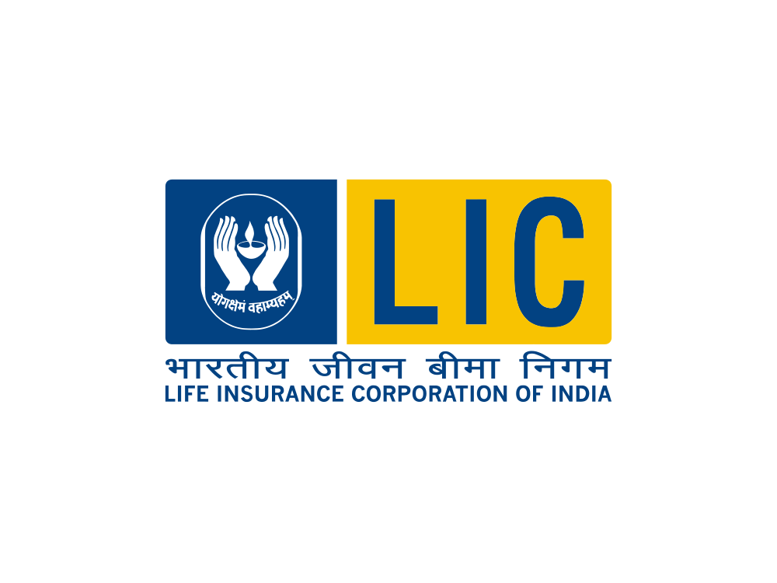
Introduction
 | The Life Insurance Corporation of India was established on 1 September 1956. Ensure and enhance the quality of life of people through financial security by providing products and services of aspired attributes with competitive returns, and by rendering resources for economic development. Head of the LIC is Siddartha Mohanty

Slide 4
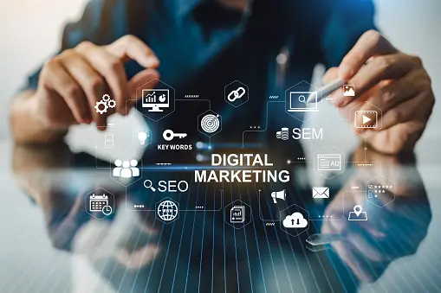
Digital Marketing :
Digital marketing, also called online marketing, is the promotion of brands to connect with potential customers using the internet and other forms of digital communication. This includes not only email, social media, and web-based advertising, but also text and multimedia messages as a marketing channel.
Key components of digital marketing:
Website marketing
Social media marketing
Email marketing
Search engine marketing
Content marketing
Affiliate marketing
Display advertising
Video marketing

Slide 5
Choosing digital marketing offers a multitude of compelling reasons that make it a highly advantageous and essential strategy in today’s business landscape. Here are some key reasons why you should opt for digital marketing: In conclusion, choosing digital marketing is an indispensable decision for any business or individual seeking growth and success in the modern…

Slide 6
LIC Company
Ownership: LIC is a state-owned insurance and investment company. It was founded in 1956 when the Indian Parliament passed the Life Insurance of India Act.
Products: LIC offers a wide range of life insurance, pension, and investment products. These include term insurance, endowment plans, ULIPs (Unit Linked Insurance Plans), and more.
Market Presence: LIC has a vast network of branches and agents across India, making it one of the most accessible insurance providers in the country.
Investment Role: LIC is also a significant player in India's financial markets. It invests a substantial portion of its funds in government securities and various other investments.
Social Initiatives: LIC has been involved in various social and community initiatives, including supporting government schemes and rural development.

Slide 7
Strategies of LIC Company:
Diverse Product Portfolio: LIC offers a wide array of insurance and investment products to cater to the varying needs of its customers. This includes traditional endowment plans, term insurance, ULIPs, pension plans, and health insurance.
Market Penetration: LIC has a significant focus on market penetration. It has a vast network of branches, agents, and customer service centers across the country, making its products easily accessible to a large population.
Customer-Centric Approach: Customer service is a top priority for LIC. They aim to provide excellent service and support to policyholders, including timely claims processing and grievance redressal.
Emphasis on Technology: Like most businesses, LIC is investing in technology to improve operational efficiency and enhance customer experience. Online policy issuance, premium payments, and customer portals have become essential parts of its strategy.

Slide 8
Brand strategy of LIC:
Trustworthiness: LIC has built a strong reputation for trust and reliability over decades. They emphasize their role in securing the financial future of policyholders.
Extensive Network: LIC's brand strategy focuses on its vast network of branches and agents, ensuring that its services are accessible to people in every corner of India.
Traditional Values: The brand capitalizes on India's traditional values, portraying itself as a trusted, family-oriented institution.
Marketing and Advertising: LIC has utilized various marketing and advertising campaigns to maintain and strengthen its brand image

Slide 9
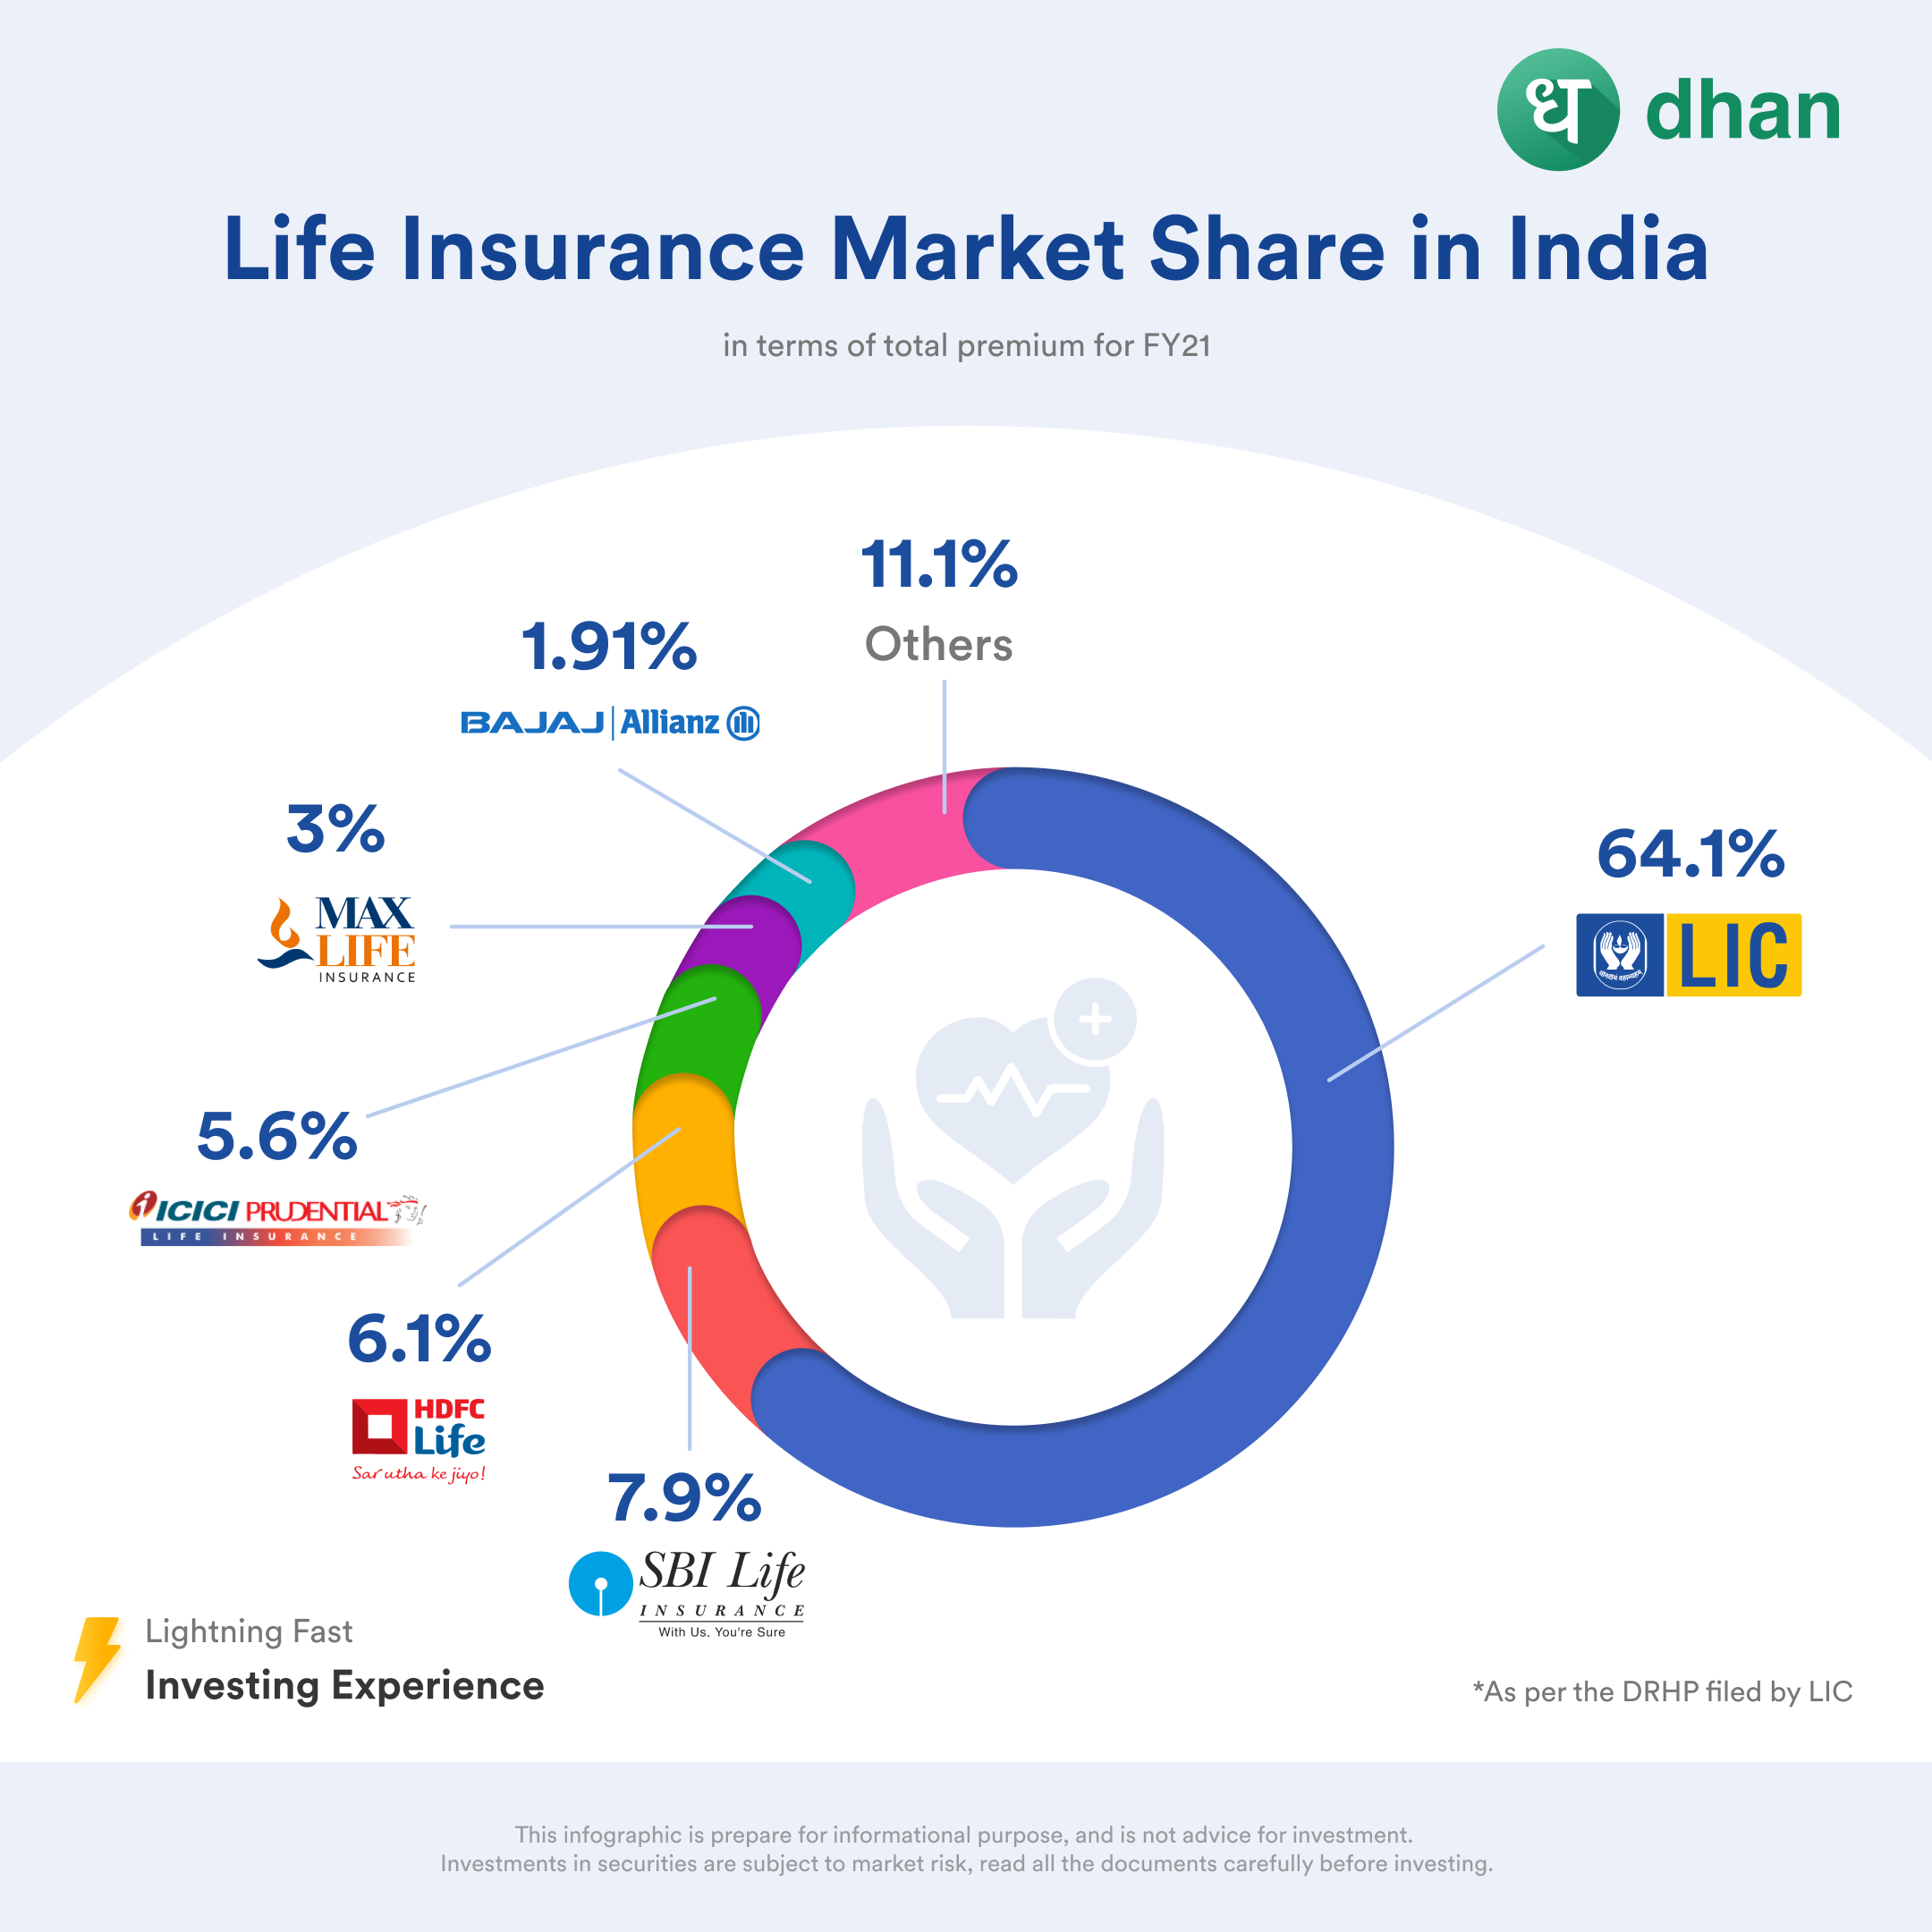
Competitors for LIC company:
The top 3 competitors of LIC are:
SBI Life Insurance
Sahara Life Insurance
HDFC Standard Life
And from the above all competitors,
LIC is the market leader covering 66% of the market.

Slide 10
SEO and Keywords:
These are specific targeted keyword of LIC company:
Lic India
Lic login
Lic of India
Lic online payment
Scandals lic
Lic premium payment
The cliffs lic

Slide 11
Digital promotion strategies:
Content blogs:
Educational Content: Create a blog with articles about life insurance, financial planning, and related topics to educate customers.
Website:
User-Friendly Design: Ensure a responsive and easy-to-navigate website.
Digital platform:
Social Media: Maintain active profiles on platforms like Facebook, Twitter, and LinkedIn for customer engagement and updates.
Digital promotion strategies:
Analytics: Continuously monitor and analyze digital marketing efforts for optimization.

Slide 12
Brand study ,competitor analysis & buyers persona:
Research brand:
The Life Insurance Corporation of India (LIC) is a government-owned insurance and investment company in India. LIC is not typically associated with a "research brand" in the same way that universities, research institutions, or technology companies might have research arms or brands.
Mission/Values:
"Ensure and enhance the quality of life of people through financial security by providing products and services of aspired attributes with competitive returns, and by rendering resources for economic development."
USP:
Pan-India Presence: LIC has an extensive network of branches and agents across the country. This widespread presence makes it accessible to customers in even remote areas of India.

Slide 13
Anaylze brand tone :
Traditional and Time-Tested: LIC's identity is rooted in tradition and longevity. This traditional approach communicates stability and reliability
Brand identity:
National Pride: LIC takes pride in being a government-owned company. Its brand identity reflects a sense of patriotism and a commitment to serving the nation.

Slide 14
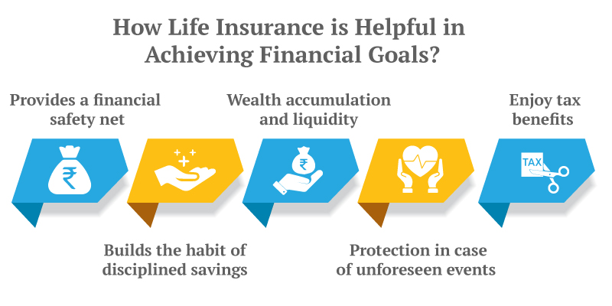
5 smart goals and KPIs of lic company:

Slide 15

Poster Design:

Slide 16
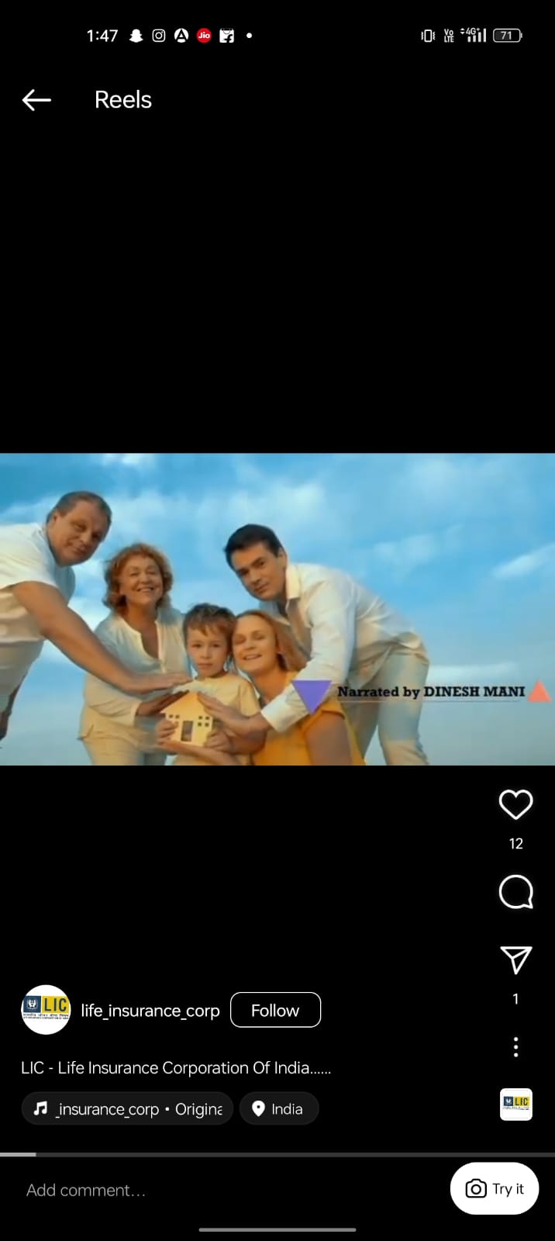
Content curation
https://www.instagram.com/reel/ClDL7TZBQIl/?igshid=NjFhOGMzYTE3ZQ==

Slide 17
Brand curation of LIC:
Approach: Showcase LIC's commitment to policyholders through various customer-centric initiatives and personalized services.
Product Portfolio: Highlight the diverse range of insurance and investment products offered by LIC, catering to different needs and preferences.
Financial Strength: Emphasize LIC's strong financial position and its ability to meet policyholder obligations.
Social Responsibility: Promote LIC's contributions to society, such as support for social causes and community development.
Digital Transformation: Showcase LIC's efforts in adopting digital technologies for customer convenience and operational efficiency.

Slide 18
Team contribution to PPT:
A.Haritha{team member}:
I brought up introduction about LIC company from internet. And also about digital marketing.
D.Sindhu{team member}:
I referred information about LIC company, strategies and brand strategies of LIC company from internet.
B.Sai sruthi{team member}:
My topic is about competitors of LIC, SEO and keywords and digital promotion strategies.

Slide 19
A.Harika{team member}:
I collected information about brand study, competitor analysis & buyers persona and also 5 KPIS and smart goals.
R.pratyusha {TEAM LEADER}:
I was created poster from canva. And after I took a reel from Instagram and copied link from it ,after that i pasted and took screenshot and inserted it.
After that I gather the information from net about brand curation.

Slide 20
Thank you

